Slide 1

Academic Session 2026-27
ODD Semester July-Dec 2026
UNIVERSITY INSTITUTE OF ENGINEERING AND TECHNOLOGY
Department of TT
Bachelor of Engineering (B.E.) – CSE
Advanced Data Structures / Semester 3
(CS220)
Unit No. 1 Chapter No. 1.1 Lecture No. 12
Topic : Multi-Dimensional Arrays — Representation and Applications
Abhishek Thakur (E19789) Technical Trainer
Sourav Jaiswal (E19756)-MSC Technical Trainer

Slide 2
Learning Objectives
Define multi-dimensional arrays and understand their memory layout.
Compute address of any element in 2D and 3D arrays using row-major and column-major formulas.
Perform traversal and basic operations on 2D arrays (matrix addition, multiplication).
Identify real-world applications of multi-dimensional arrays.

Slide 3
Multi-Dimensional Arrays — Definition and Types
2D Array: A matrix of rows and columns. Declared as: int A[rows][cols]. Accessed as A[i][j].
3D Array: A collection of 2D arrays. Declared as: int A[planes][rows][cols]. Accessed as A[p][i][j].
Memory: Stored linearly in RAM. C/C++ uses row-major; Fortran/MATLAB uses column-major order.
Row-major formula: A[i][j] = Base + (i x cols + j) x size
Column-major formula: A[i][j] = Base + (j x rows + i) x size

Slide 4
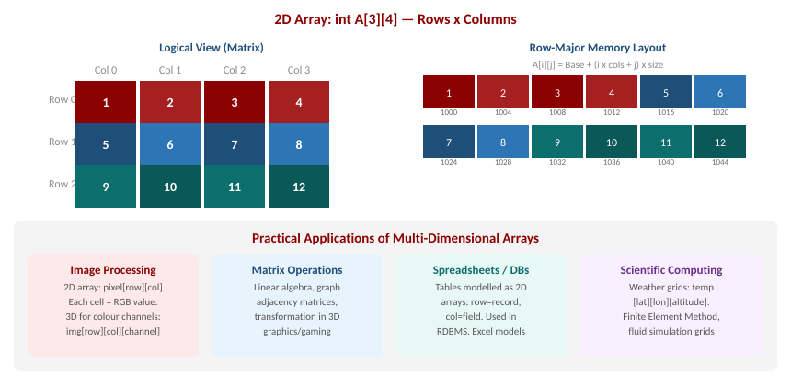
2D Array Layout, Memory Mapping and Applications

Slide 5
Operations on 2D Arrays
Traversal: Visit every element using nested loops: for i=0 to r-1: for j=0 to c-1: process A[i][j]. Time: O(r x c).
Matrix Addition: C[i][j] = A[i][j] + B[i][j] for all i, j. Requires both matrices same dimensions. Time: O(n sq.).
Matrix Multiplication: C[i][j] = sum over k of A[i][k] x B[k][j]. Requires A cols = B rows. Time: O(n cubed) naive.
Transpose: Swap A[i][j] and A[j][i]. For an n x n matrix: Time O(n sq.), Space O(1) in-place.
3D example: A colour image: pixels[height][width][3] where 3 channels are R, G, B.

Slide 6
Summary of the Lecture
2D arrays are matrices of rows x columns stored linearly in memory (row-major in C/C++).
Row-major address: A[i][j] = Base + (i x cols + j) x size.
Column-major address: A[i][j] = Base + (j x rows + i) x size (Fortran/MATLAB).
3D arrays extend to planes x rows x cols; used in image (RGB), scientific, and game data.
Key applications: image processing, matrix algebra, spreadsheets, weather simulation, game maps.

Slide 7

Next Lecture
Chapter 1.3 — Introduction to Linked Lists: singly linked list, traversal, insertion, and deletion.

Slide 8
Quiz/ FAQ's
Q1. For int A[4][5] with Base=3000, find the address of A[2][3] using row-major order. (int=4 bytes)
Q2. Write the algorithm for multiplying two n x n matrices. What is its time complexity?
Q3. How is a colour image represented as a 3D array? What does each dimension represent?

Slide 9
References/ Articles/ Videoseferences/ Articles/ Videos
Seymour Lipschutz, Data Structures, Schaum's Outlines, McGraw-Hill, Ch. 4-5.
Reema Thareja, Data Structures Using C, Oxford University Press, Ch. 3.
GeeksforGeeks — Multidimensional Arrays: https://www.geeksforgeeks.org/multidimensional-arrays-in-c/

Slide 10
Thank You
For queries
Email: abhishek.e19789@cumail.in

